Slide 1




Credit Card Risk Analysis
Exploratory Data Analysis on Loan Applications
Presented by
[ANNAVAJJALA RAMPRASAD]

Slide 2

PROBLEM STATEMENT
OBJECTIVES
Perform EDA to find patterns of repayment vs default.
Identify key drivers of loan default.
Handle missing values, outliers, imbalance in data.
Provide data-driven insights for loan approval decisions.
Loan companies struggle due to incomplete or missing credit history of applicants.
This leads to two risks:
1) Approving risky clients → financial losses.
2)Rejecting good clients → loss of business.
A clear need exists to use data analysis to identify reliable applicants and reduce credit risk.

Slide 3

BUSINESS UNDERSTANDING
•Credit risk is a major issue for banks, as defaults directly affect profitability.
•Our goal is to find borrowers who are likely to not pay back their loans, so lenders can take less risk.
•The project acts like a real business case, and EDA helps find important risk factors.

Slide 4
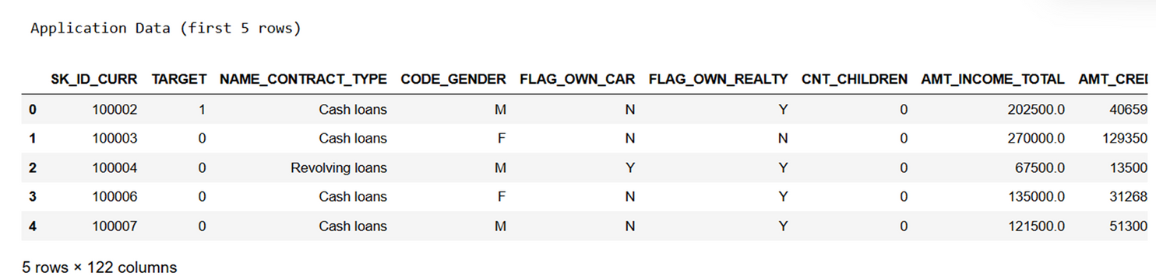
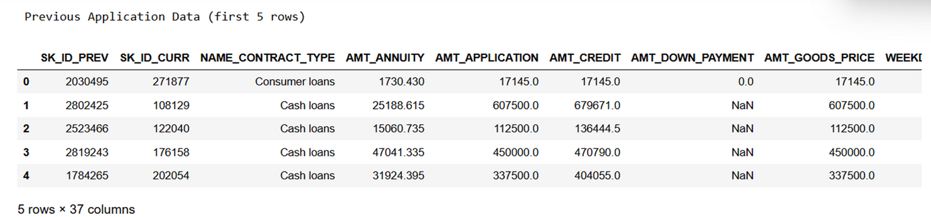
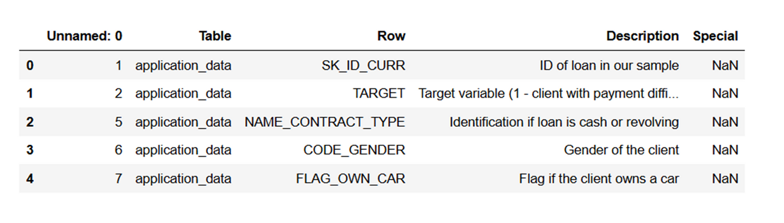
DATA OVERVIEW
Application Data → 307,511 records, 122 features (loan application details).
Previous Applications → 1,670,214 records, 37 features (past loan history).
Columns Description → 160 rows (dictionary of feature meanings).

Slide 5
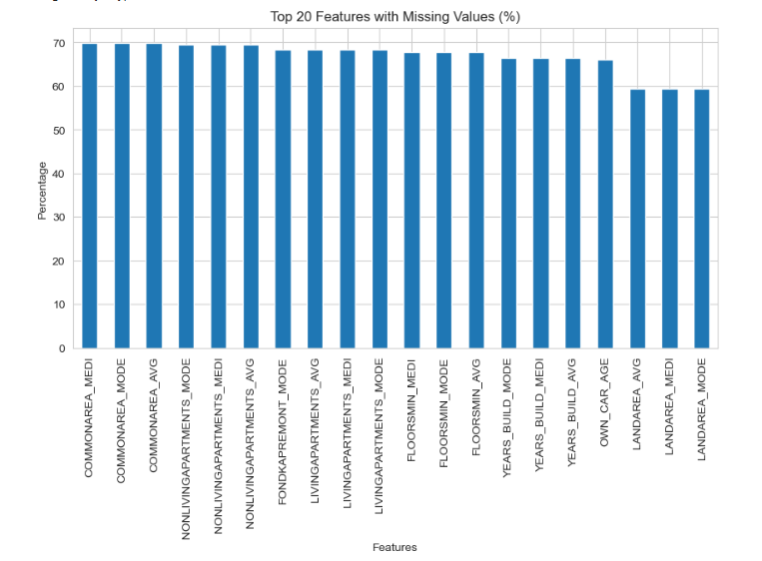

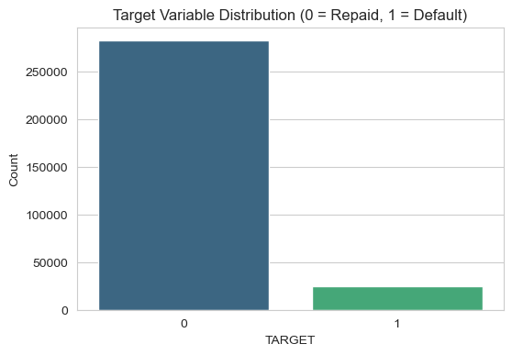

DATA CLEANING & PREPARATION
Missing values found in Occupation, Annuity, Down Payment.
Negative values fixed (Days Birth, Days Employed).
Outliers checked in income & loan amounts.
Target imbalance: Most clients repaid, fewer defaults.

Slide 6
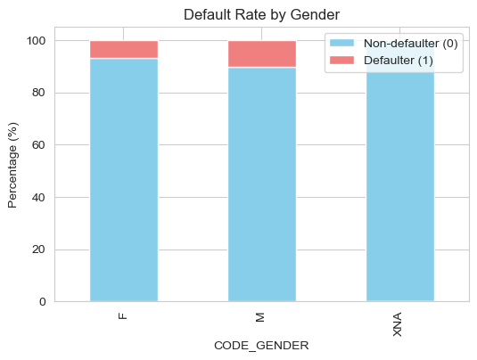
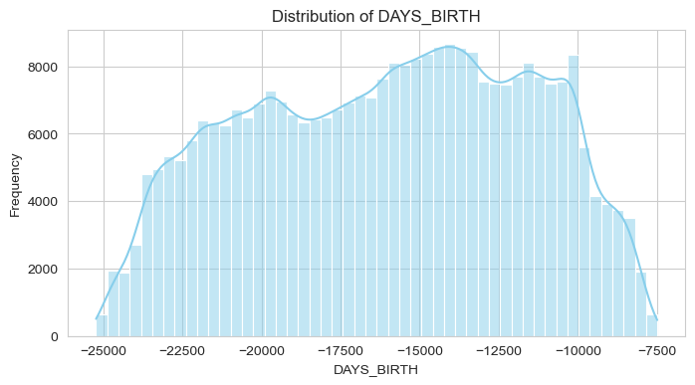
DEMOGRAPHIC ANALYSIS
Most applicants are 30–45 years old.
Younger clients show slightly higher risk of default.
Gender split: more males, but default rate is similar across genders.

Slide 7
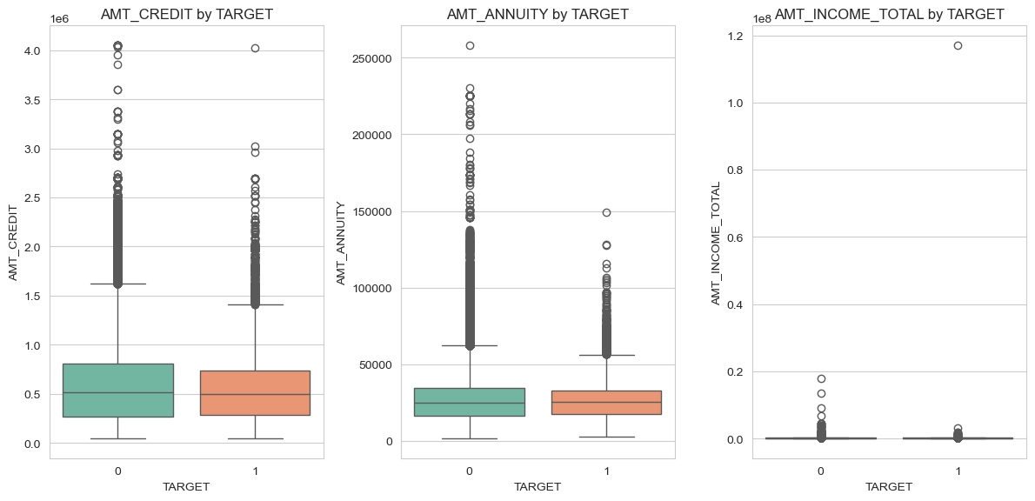
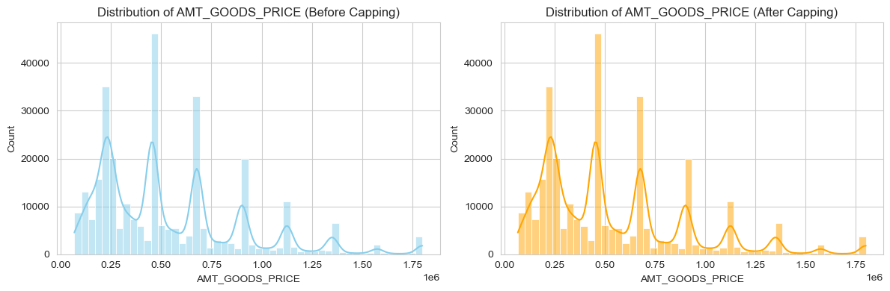
FINANCIAL ANALYSIS
Defaulters generally have slightly lower income & credit amounts.
Annuity payments are relatively higher among defaulters.
Loan amounts (Goods Price) vary widely, with outliers detected and capped.
Financial stability indicators help differentiate safe vs risky clients.

Slide 8
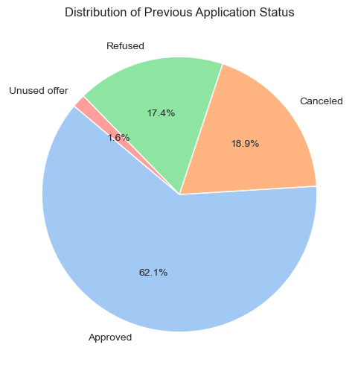
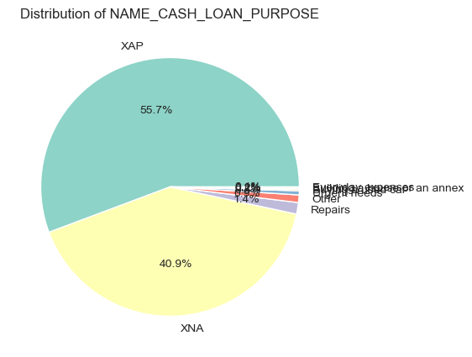
PREVIOUS APPLICATIONS ANALYSIS
62% Approved, ~18% Cancelled, ~17% Refused, ~2% Unused.
Loan purposes mainly fall under XAP (55.7%) and XNA (40.9%).
Very few loans were for repairs or business expansion.
Previous status & purpose give important signals of client reliability.

Slide 9
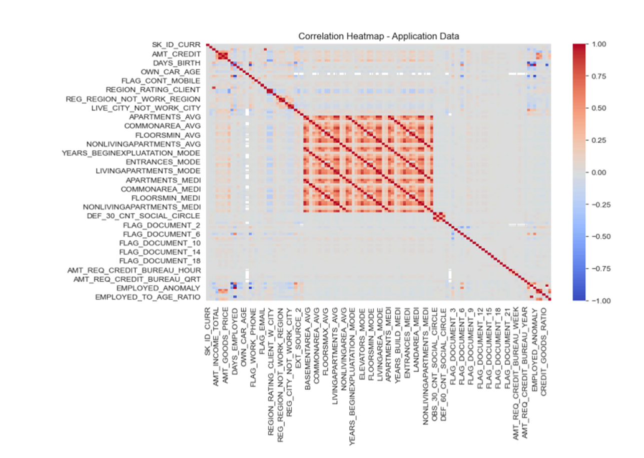
CORRELATION
Correlation Heatmap-Application Data
Strong correlations observed among housing-related variables (e.g., APARTMENTS, COMMONAREA, LIVINGAREA).
Credit Amount (AMT_CREDIT) is positively correlated with Goods Price (AMT_GOODS_PRICE).
Days variables (DAYS_BIRTH, DAYS_EMPLOYED) show meaningful correlation with repayment behavior.
High multicollinearity exists between similar features → feature reduction may be required in modeling.
Heatmap confirms both financial and demographic variables are important for credit risk.

Slide 10
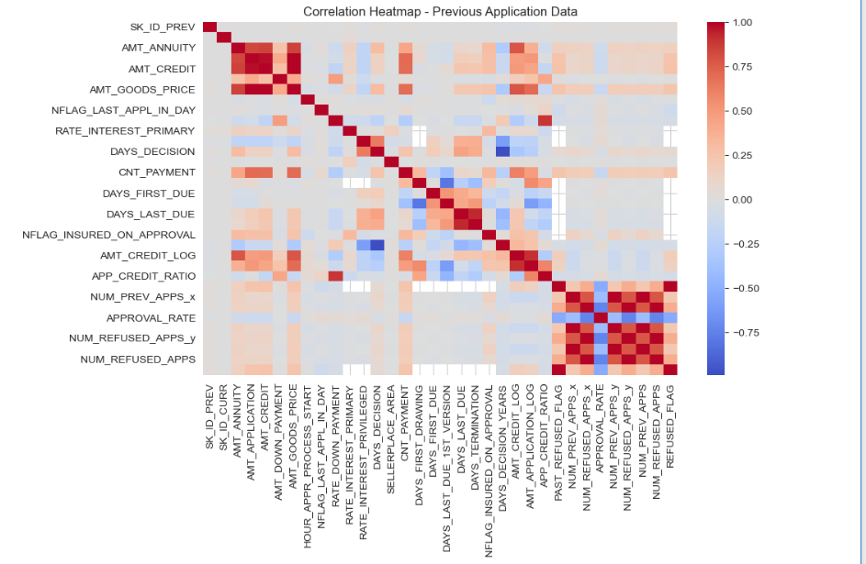
Correlation Heatmap- Previous Application Data
Credit Amount (AMT_CREDIT) strongly correlates with Annuity (AMT_ANNUITY) and Goods Price (AMT_GOODS_PRICE) → bigger loans lead to higher payments.
APP_CREDIT_RATIO and Approval Rate are linked, reflecting risk tied to loan approval chances.
Number of Previous Applications (NUM_PREV_APPS) correlates with Number of Refused Applications → frequent applications increase rejection chances.
Days-related features (e.g., DAYS_DECISION, DAYS_FIRST_DUE, DAYS_LAST_DUE) show weak-to-moderate correlation, representing timing patterns of repayments.
Heatmap indicates past credit behavior and repayment history are strong signals of default risk.

Slide 11
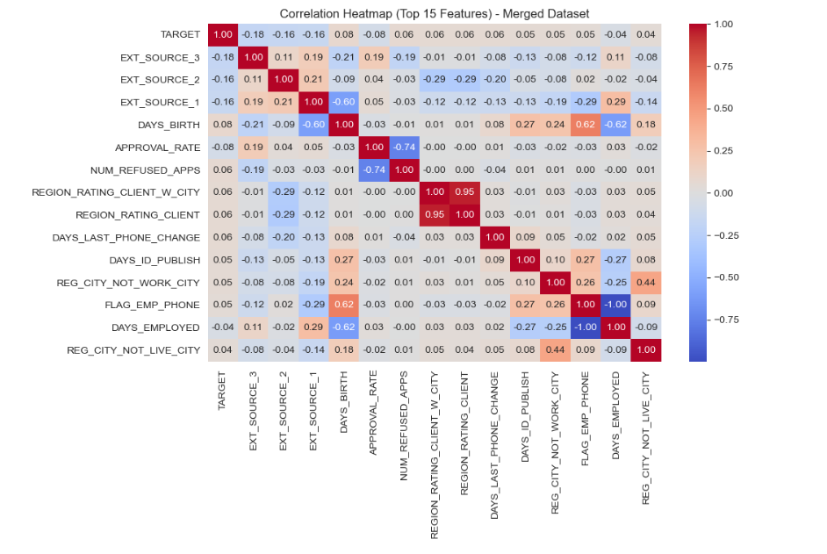
Correlation Heatmap(Top 15 Features) - Merged Dataset
EXT_SOURCE_2, EXT_SOURCE_3, EXT_SOURCE_1 have the strongest negative correlation with TARGET → higher external scores = lower default risk.
DAYS_BIRTH is negatively correlated with TARGET → younger clients are riskier, older clients are safer.
Approval Rate and Number of Refused Applications show moderate links to default → past loan history is an important risk signal.
Region Rating variables (REGION_RATING_CLIENT, REGION_RATING_CLIENT_W_CITY) are slightly correlated → weaker regions show higher default risk.
Employment-related features (DAYS_EMPLOYED, FLAG_EMP_PHONE) also provide additional insight into repayment ability.
Overall: External credit scores + age + past loan approvals/refusals are the strongest predictors of loan default.

Slide 12
DRIVER FEATURE SUMMARY
Key Drivers of Loan Default identified:
External Credit Scores (EXT_SOURCE_1, EXT_SOURCE_2, EXT_SOURCE_3)
→ Strongest predictors; lower scores = higher default risk.
Applicant Age (DAYS_BIRTH)
→ Younger clients more likely to default; older applicants more reliable.
Previous Loan History
→ Higher refused applications → more default risk.
→ Higher approval rates → lower default risk.
Financial Ratios
→ Credit/Income ratio helps detect overstretched borrowers.
→ Annuity & credit amounts moderately related to repayment ability.
Regional & Employment Factors
→ Clients in weaker-rated regions and unstable jobs show slightly higher risk.

Slide 13
INSIGHTS & RECOMMENDATIONS
Most defaults linked to low external credit scores and younger age groups.
Past loan history (approvals/refusals) is a strong predictor of repayment ability.
Financial ratios (credit/income, annuity amounts) highlight overstretched borrowers.
Target variable imbalance observed → requires careful handling in modeling.
Recommendation: Banks should use these drivers for better risk segmentation.

Slide 14
Conclusion
EDA successfully identified key drivers of credit risk.
Patterns help differentiate safe vs risky clients.
Insights can reduce losses from defaulters while ensuring good clients are not rejected.
Sets a strong base for predictive modeling & credit scoring systems.

Slide 15

ANNAVAJJALA RAMPRASAD
email:- annavajjalaramprasad10@gmail.com
Mobile:- 9989685803

Slide 16
Thank you

